Slide 1
From Sticky Notes to Making it Stick: Executive Functioning and Organizational Strategies to Support Student Success
Lauren Bonnet, PhD, CCC-SLP
Sandi Stoppel, OTR/L
Marbea Tammaro, MEd, OTR/L
Arlington Public Schools

Slide 2
“Children aren’t born with these skills—they are born with the potential to develop them.”
Harvard Center for the Developing Child

Slide 3
InBrief: Executive Function: Skills for Life and Learning
Harvard Center on the Developing Child

Slide 4
What is Executive Functioning?
Inhibitory Control Working Memory Mental Flexibility
Executive function and self-regulation skills are the mental processes that enable us to plan, focus attention, remember instructions, and juggle multiple tasks successfully. Just as an air traffic control system at a busy airport safely manages the arrivals and departures of many aircraft on multiple runways, the brain needs this skill set to filter distractions, prioritize tasks, set and achieve goals, and control impulses.
Center on the Developing Child, Harvard University - Executive Function and Self Regulation https://developingchild.harvard.edu/science/key-concepts/executive-function/
Response Inhibition in the Stop Signal Paradigm https://www.ncbi.nlm.nih.gov/pubmed/18799345

Slide 5
What is Executive Functioning?
neuropsychological concept referring to the cognitive processes required to plan and direct activities, including task initiation and follow through, working memory, sustained attention, performance monitoring, inhibition of impulses and goal directed persistence (Dawson & Guare, 2004). From Wisconsin Assistive Technology Initiative, Chapter 9.

Slide 6
Includes the following skills:
Sustaining attention - working memory
Shifting attention - mental flexibility
Inhibiting impulses - inhibitory control
Initiating activity - inhibitory control
Planning and organization - working memory, mental flexibility
Organizing material - working memory, mental flexibility
Emotional control - inhibitory control, mental flexibility
Time management - inhibitory control, mental flexibility, working memory
All of these executive functioning skills work together to support self-organization, information management, time management and materials management.

Slide 7
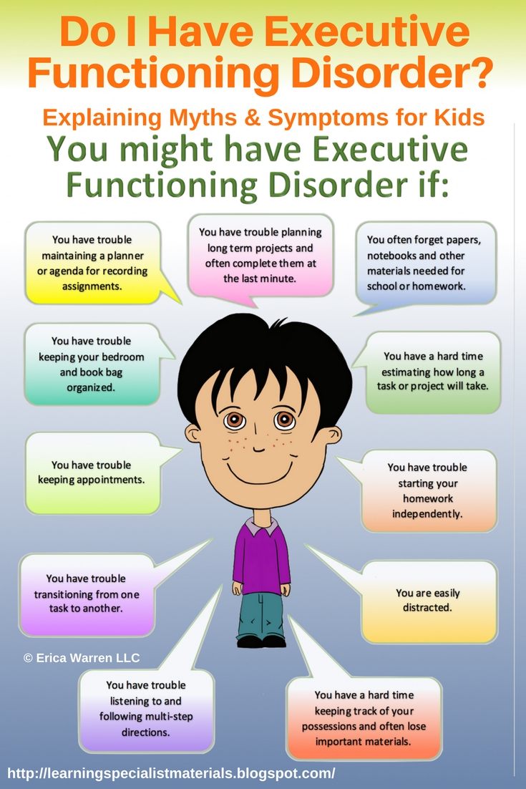
Notes:
Elementary school teacher is the Executor: who organizes and direct the system. (color coded classroom- next slide)

Slide 8
Notes:
For some students, the uber color coding serves as a model for future organization. For other students, they hit middle school and the wheels come off of the bus. There is a new class every 42 minutes, a locker schedule, more students lend more confusion and distractions.

Slide 9
What might Executive Function difficulties look like in the classroom or in school?
Observation | Area of Difficulty
Messy desk, binder, backpack, locker | Organizing and planning
Missing/late assignments | Time management, initiating activity, working memory
Assignments not written in the agenda or has no calendar/agenda | Organizing and planning, initiating, time management
Behavior problems, difficulty recognizing others feelings & ideas are equally important. | Self-regulation, emotional control, lack of insight/overestimate ability
Not able to break down long term assignments, plan how written information fits on a page | Planning and organization
Off task, difficulty switching from one task to another, poor retrieval and use of ideas when writing | Shifting focus and attention, working memory

Slide 10
Educational Impact - Evidence/Support
What testing information might give more info about student?
School Psychologists use checklists/rating scales as the “Gold Standard” to assess in the area of executive functioning;
Behavior Rating Index of Executive Function (BRIEF)-global score and index scores on behavioral regulation (with the scales: Inhibit, Shift, and Emotional control scales) and a Metacognition Index (with scale scores of initiate, working memory, plan/organize, organization of materials and monitor).
Conner’s The Conners Comprehensive Behavior Rating Scales™(Conners CBRS™) is designed to provide a complete overview of child and adolescent concerns and disorders. It is a multi-informant assessment of children and youth across multiple settings, with rating forms for parents, teachers, and youth.
Notes:
Sandi to include info from Psych report

Slide 11
Educational Impact - Evidence/Support (continued)
Rating scales and checklists are only part of the picture.
Observe and interview the student and teachers to determine activities that indicate the ability to organize, plan, use working memory, initiate, change tasks, sustain attention, use response inhibition, and time management or other executive functions.

Slide 12
Classroom Observations - Student Characteristics
Self regulation-when tasks are demanding or boring
Problem solving strategies- plan A→ plan B
Perseveration- ideas or response choices
Persistence with goal or when attempting to complete a task
Flexibility- ability to switch from task to task or change ideas
School-Based Assessment of Executive Functions (pages 7-10- Educational Impact)
https://www.brainline.org/article/school-based-assessment-executive-functions#main-menu
Notes:
Contingency planning - mental flexibility (if A doesn’t work, try B)

Slide 13
Classroom Observations - Student Characteristics (cont’d)
Attention span and ability to sustain attention
Memory or recall
Working memory - the ability to recall needed information
Organization
Time management
Theory of mind (ability to understand the perspective of another person)
Task initiation
https://www.brainline.org/article/school-based-assessment-executive-functions#main-menu

Slide 14
Observations: Difficulties in Writing
Planning how written information will fit on a page
Writing automatically
Difficulty with organization of content in written material
Poor retrieval and use of ideas when writing
Difficulty holding and manipulating thoughts, retrieving ideas and executing written material
https://www.brainline.org/article/school-based-assessment-executive-functions#main-menu

Slide 15
Observations: Difficulties in Math
monitoring progress and self correction when doing calculations
maintaining an idea
organizing a strategy and retrieving steps accurately when calculating
organizing, storing information, retrieving information
executing steps when learning and applying memorized information such as addition facts
https://www.brainline.org/article/school-based-assessment-executive-functions#main-menu

Slide 16
Observations: Difficulties in Reading
Ability to plan, recall and use decoding strategies
Reading words fluently
Understanding and using information read in a sentence, passage, or longer article
Ability to make inferences or use strategies for reading comprehension
https://www.brainline.org/article/school-based-assessment-executive-functions#main-menu

Slide 17
Observations: Difficulties in Study Skills
Desk, backpack organization
Homework completion
Ability to read a text and glean needed information
Ability to listen and glean needed information
Turning completed homework in on time
Interpreting assignments correctly
Use of study strategies in classroom
https://www.brainline.org/article/school-based-assessment-executive-functions#main-menu

Slide 18
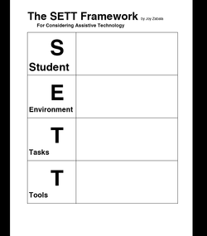
Assistive Technology Assessment - SETT Framework
http://www.joyzabala.com/

Slide 19
Assessment Tools:
Executive Function & Organization
Checklist- Wisconsin Assistive Technology Initiative Section 8 - shared through VDOE AT Network
Organization Problems Inventory- Judie Sweeney of Onion Mountain Technologies - no longer in print but still available through this link
Notes:
Marbea

Slide 20
Feature Match Time!
Explore tools to meet your student’s unique characteristics and needs

Slide 21
A Continuum of Consideration for AT Material Management
Chapter 9 WATI (access this resource through OCALI) - continuum for each area included
Start with low tech- find the most simple tool that matches student need
http://www.wati.org/wp-content/uploads/2017/10/Ch9-Organization.pdf

Slide 22
Executive Function strategies and tools - low tech
Timers, begin and stop working when others do | Consistent routines-have materials ready at beginning of the lesson
Assignment Sheet provided | Color coding
Teacher provided outline | Incredible 5 Point Scale
Self-monitoring checklist | Prioritize: need/have to, want to
Preferential seating in class/teacher proximity | File naming system
Chunk directions into smaller segments/steps | Rubber bands- class follow up (homework prompter)
Spot makers/footprints
Tape to designate area/space

Slide 23
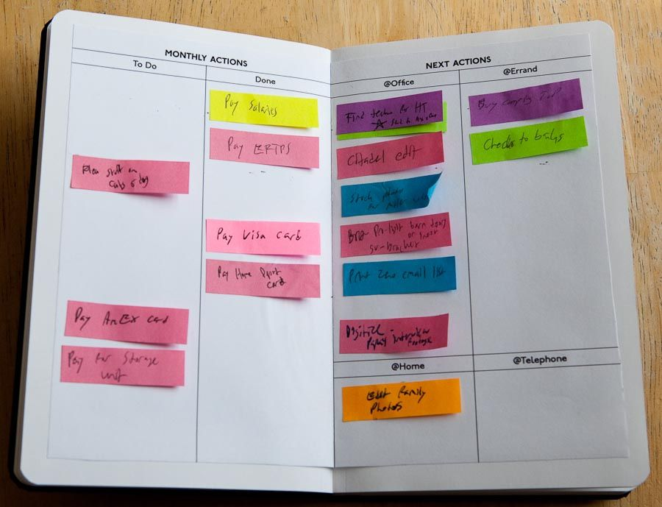
Low Tech Tools - Organizing Information
Sticky notes
Tabs
Color Coding
Highlighters
Study Guides
Graphic Organizers
Filing
Checklists
Folders/Bins/Boxes/Containers

Slide 24
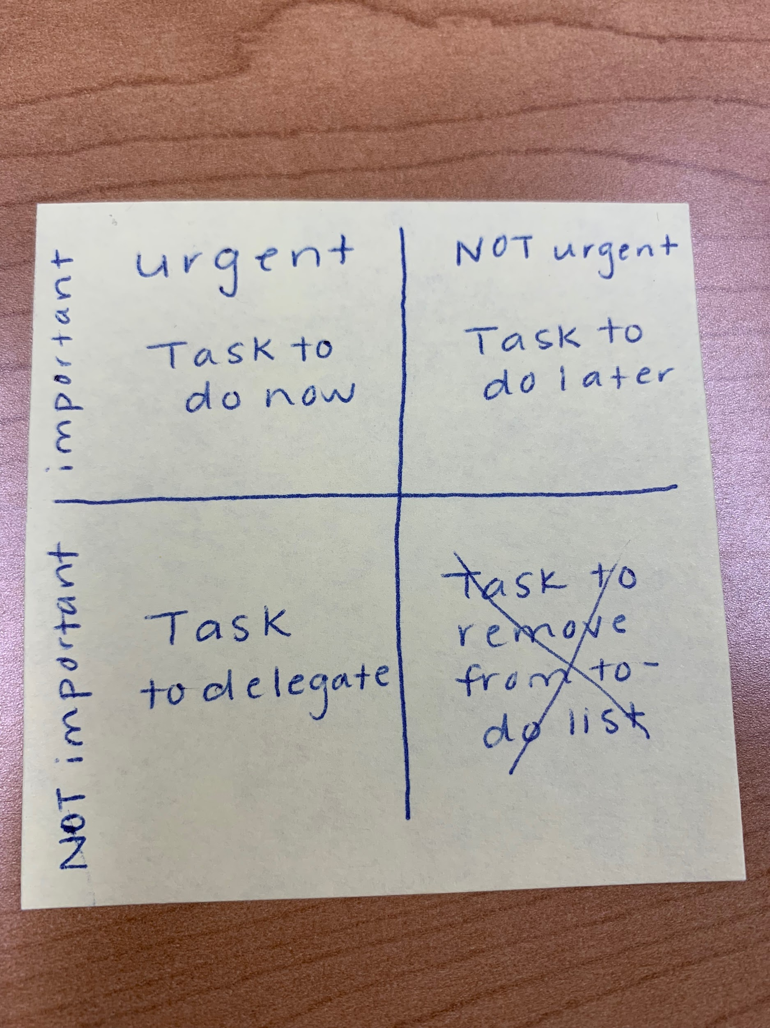
Low Tech Tools - Prioritizing Tasks

Slide 25
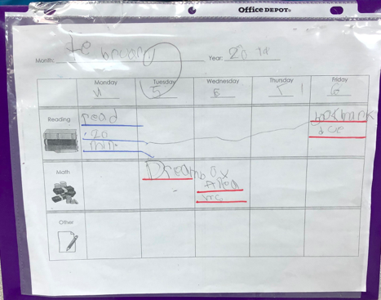
Low Tech Tools - Assignment Tracker

Slide 26
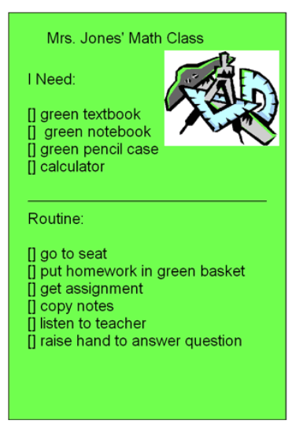
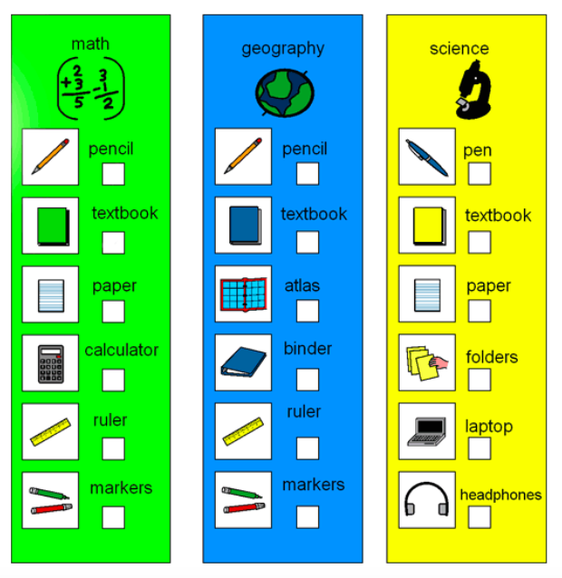
Low Tech Tool - Visual Schedule

Slide 27
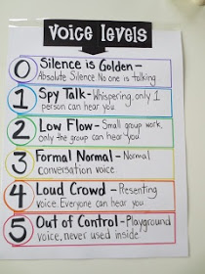
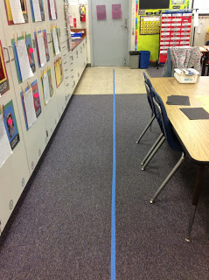
Low Tech Tool - Self-Monitoring
Am I standing in line?
Is my volume appropriate?

Slide 28
Mid-Tech Tools - Timers
Time Timer
www.online-stopwatch.com

Slide 29
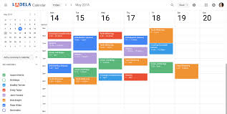
High Tech Tool - Calendar

Slide 30
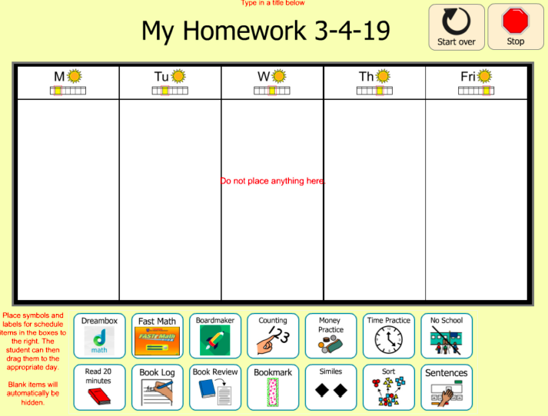
High Tech Tools: Assignment Tracker
Notes:
Boardmaker online - Kelly’s

Slide 31
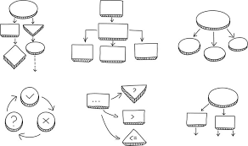
Low & High Tech Tool - Graphic Organizers
Wixie
Microsoft Word - use shapes to make organizer to fit your needs
Graphic Organizers: Guiding Principles and Effective Practice Considerations
Graphic Organizers and Implications for Universal Design for Learning

Slide 32
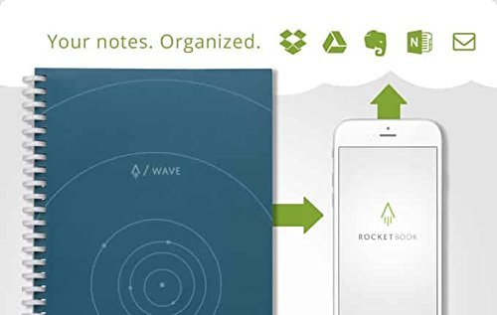
High Tech Tools: Smart Notebooks
https://www.youtube.com/watch?v=YnbhLStChMc

Slide 33
Classroom Examples
Students are not just provided with strategies and tools, but there is explicit instruction about how to use these as well as clear expectations and examples of use

Slide 34
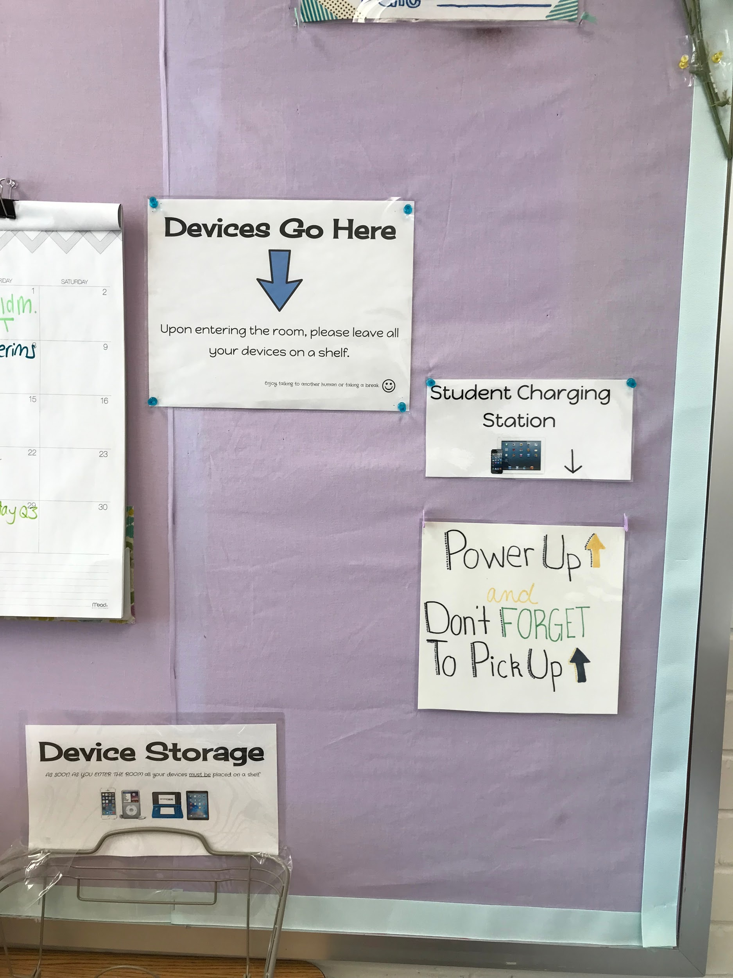
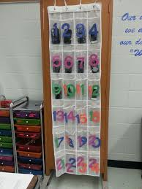
Classroom examples
Cell phone parking lot

Slide 35
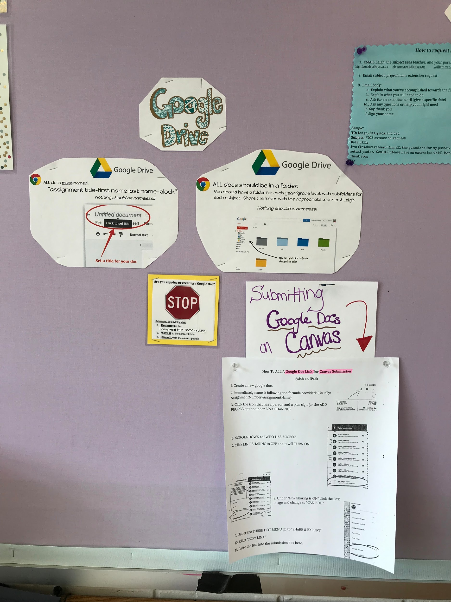
Classroom Examples
How to use, organize and access documents
Google Docs

Slide 36
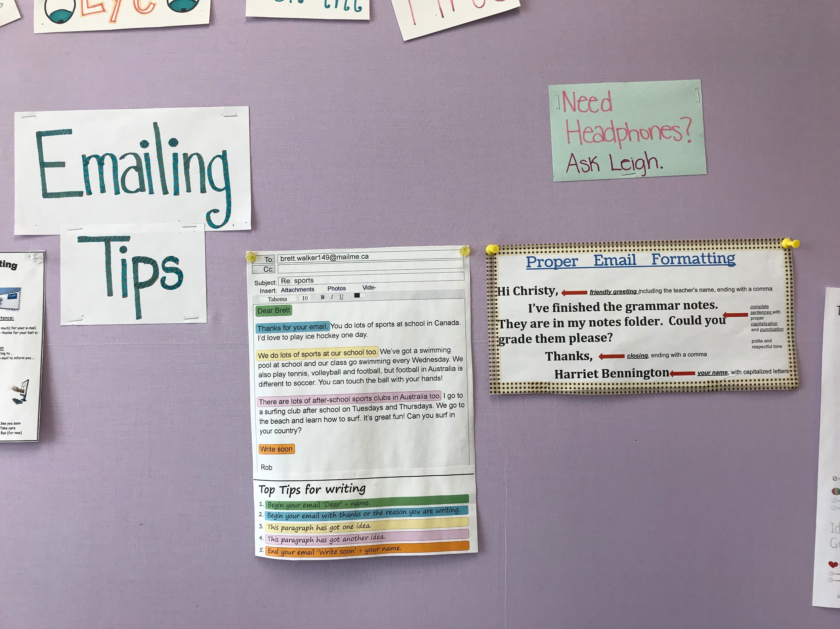
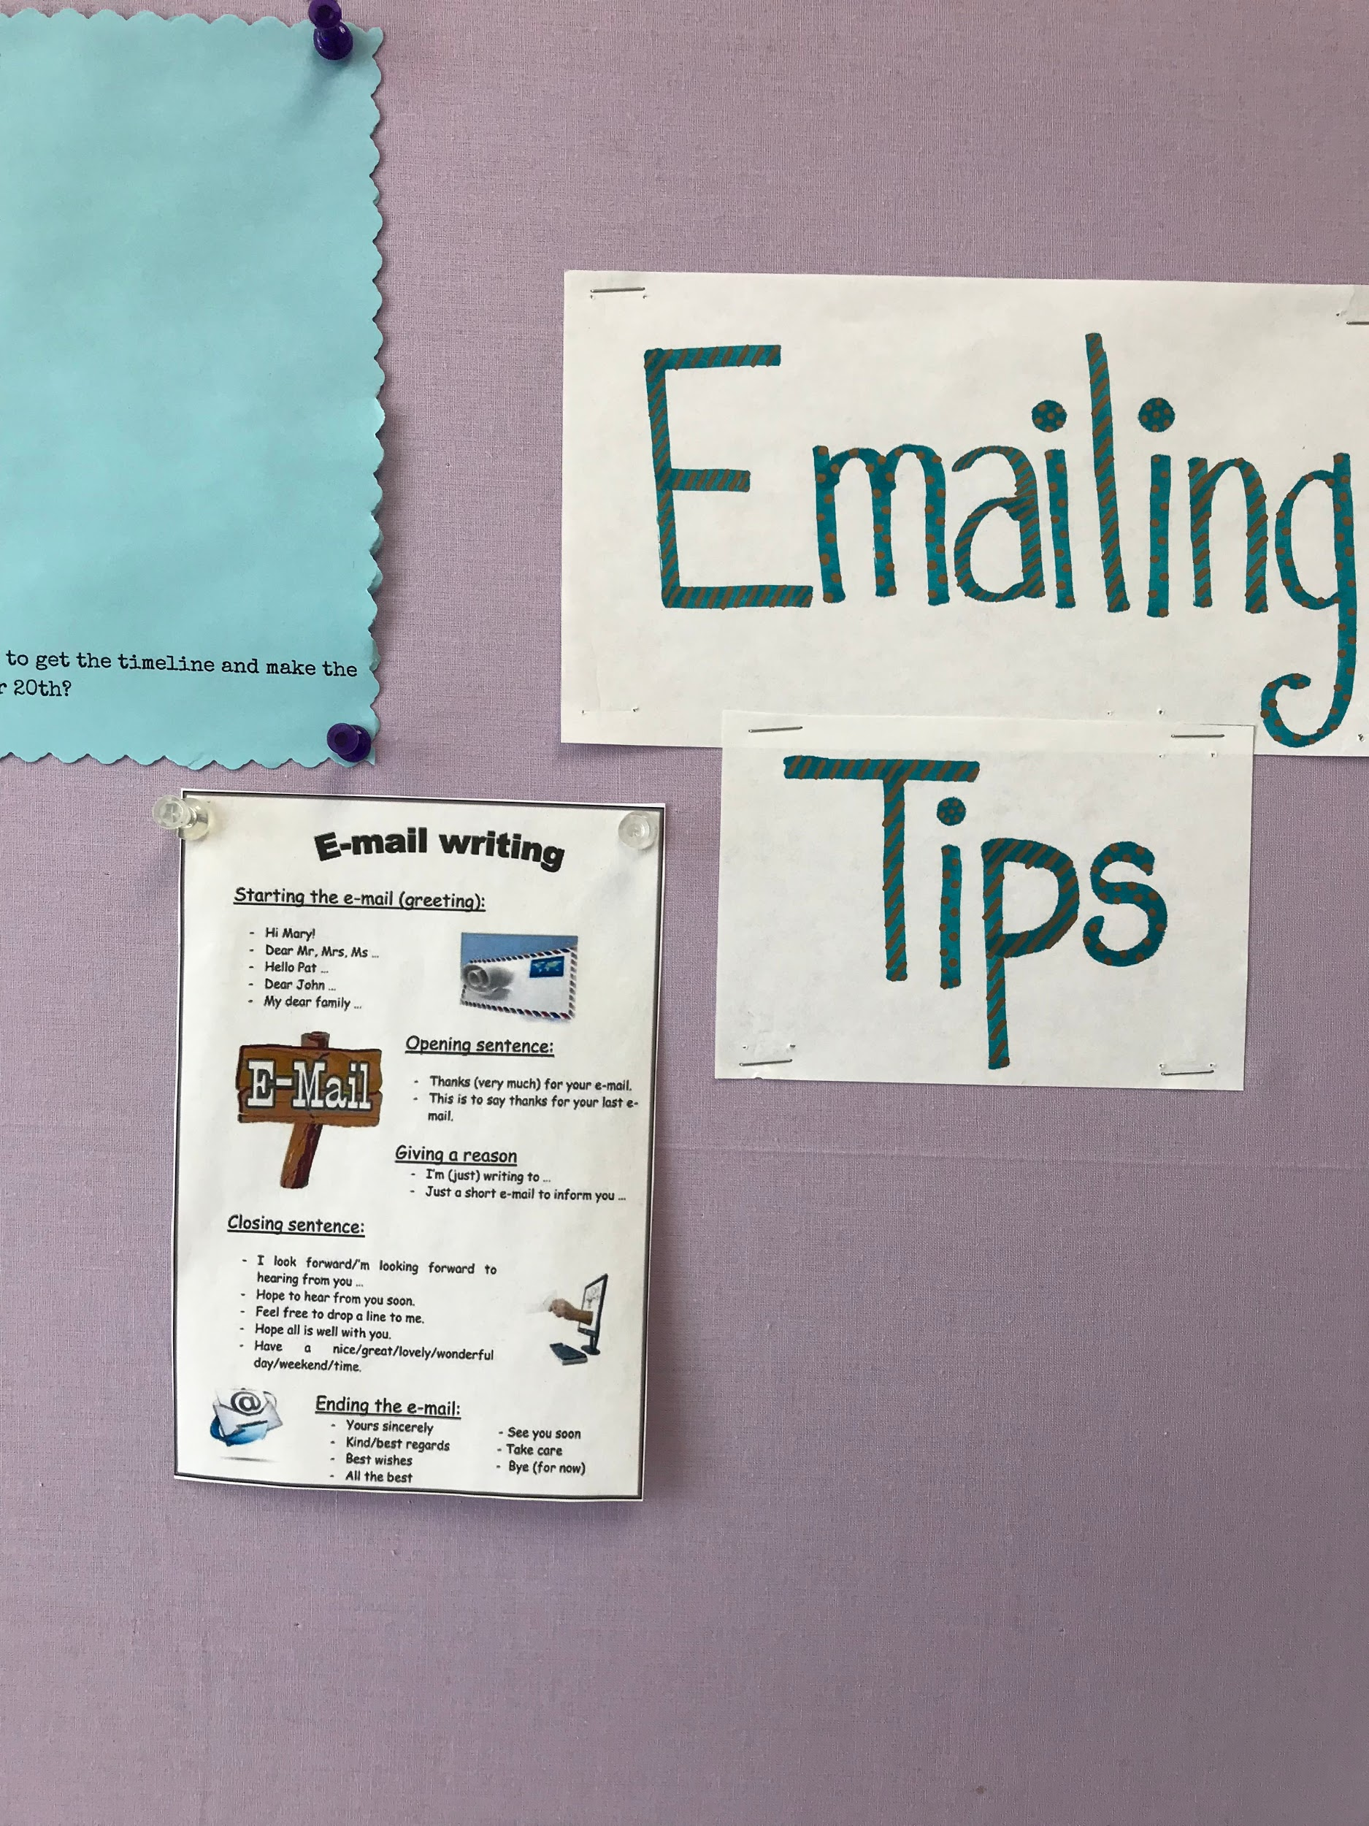
Classroom Examples
How to send an email
If you need something - ask!
Notes:
Teaches self-advocacy

Slide 37
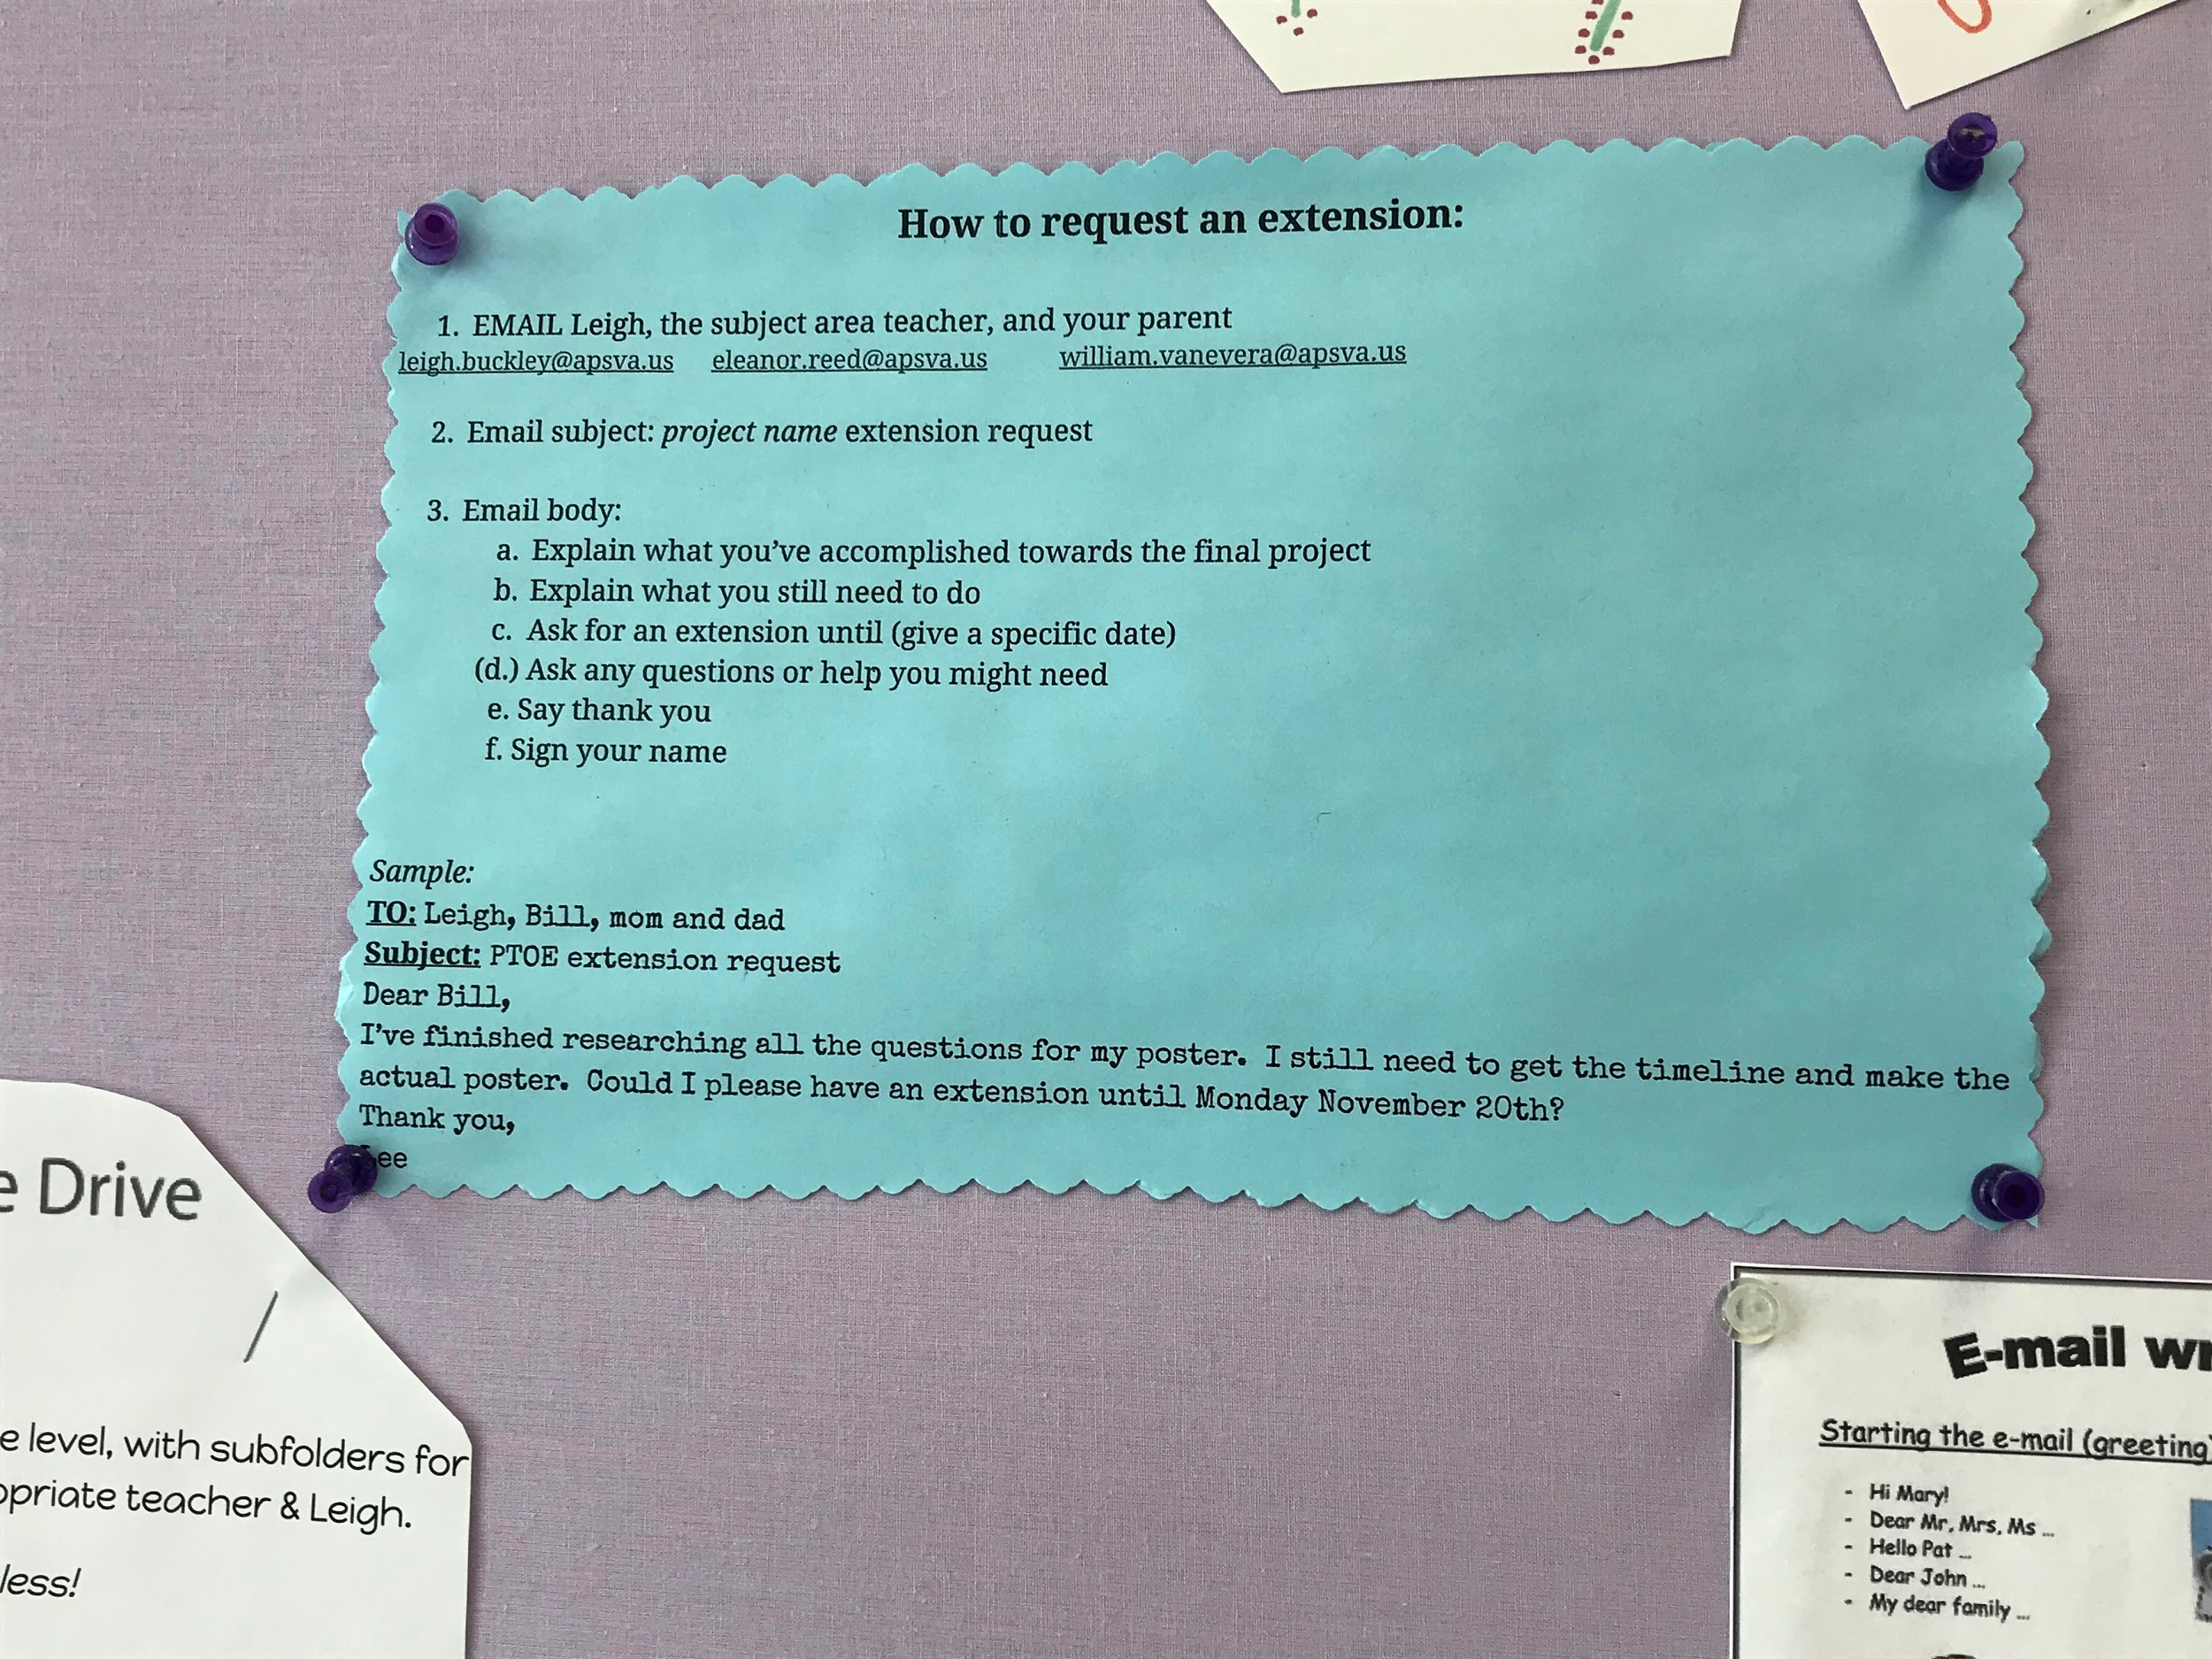
Classroom Examples
How to Request an extension with steps and a model email

Slide 38
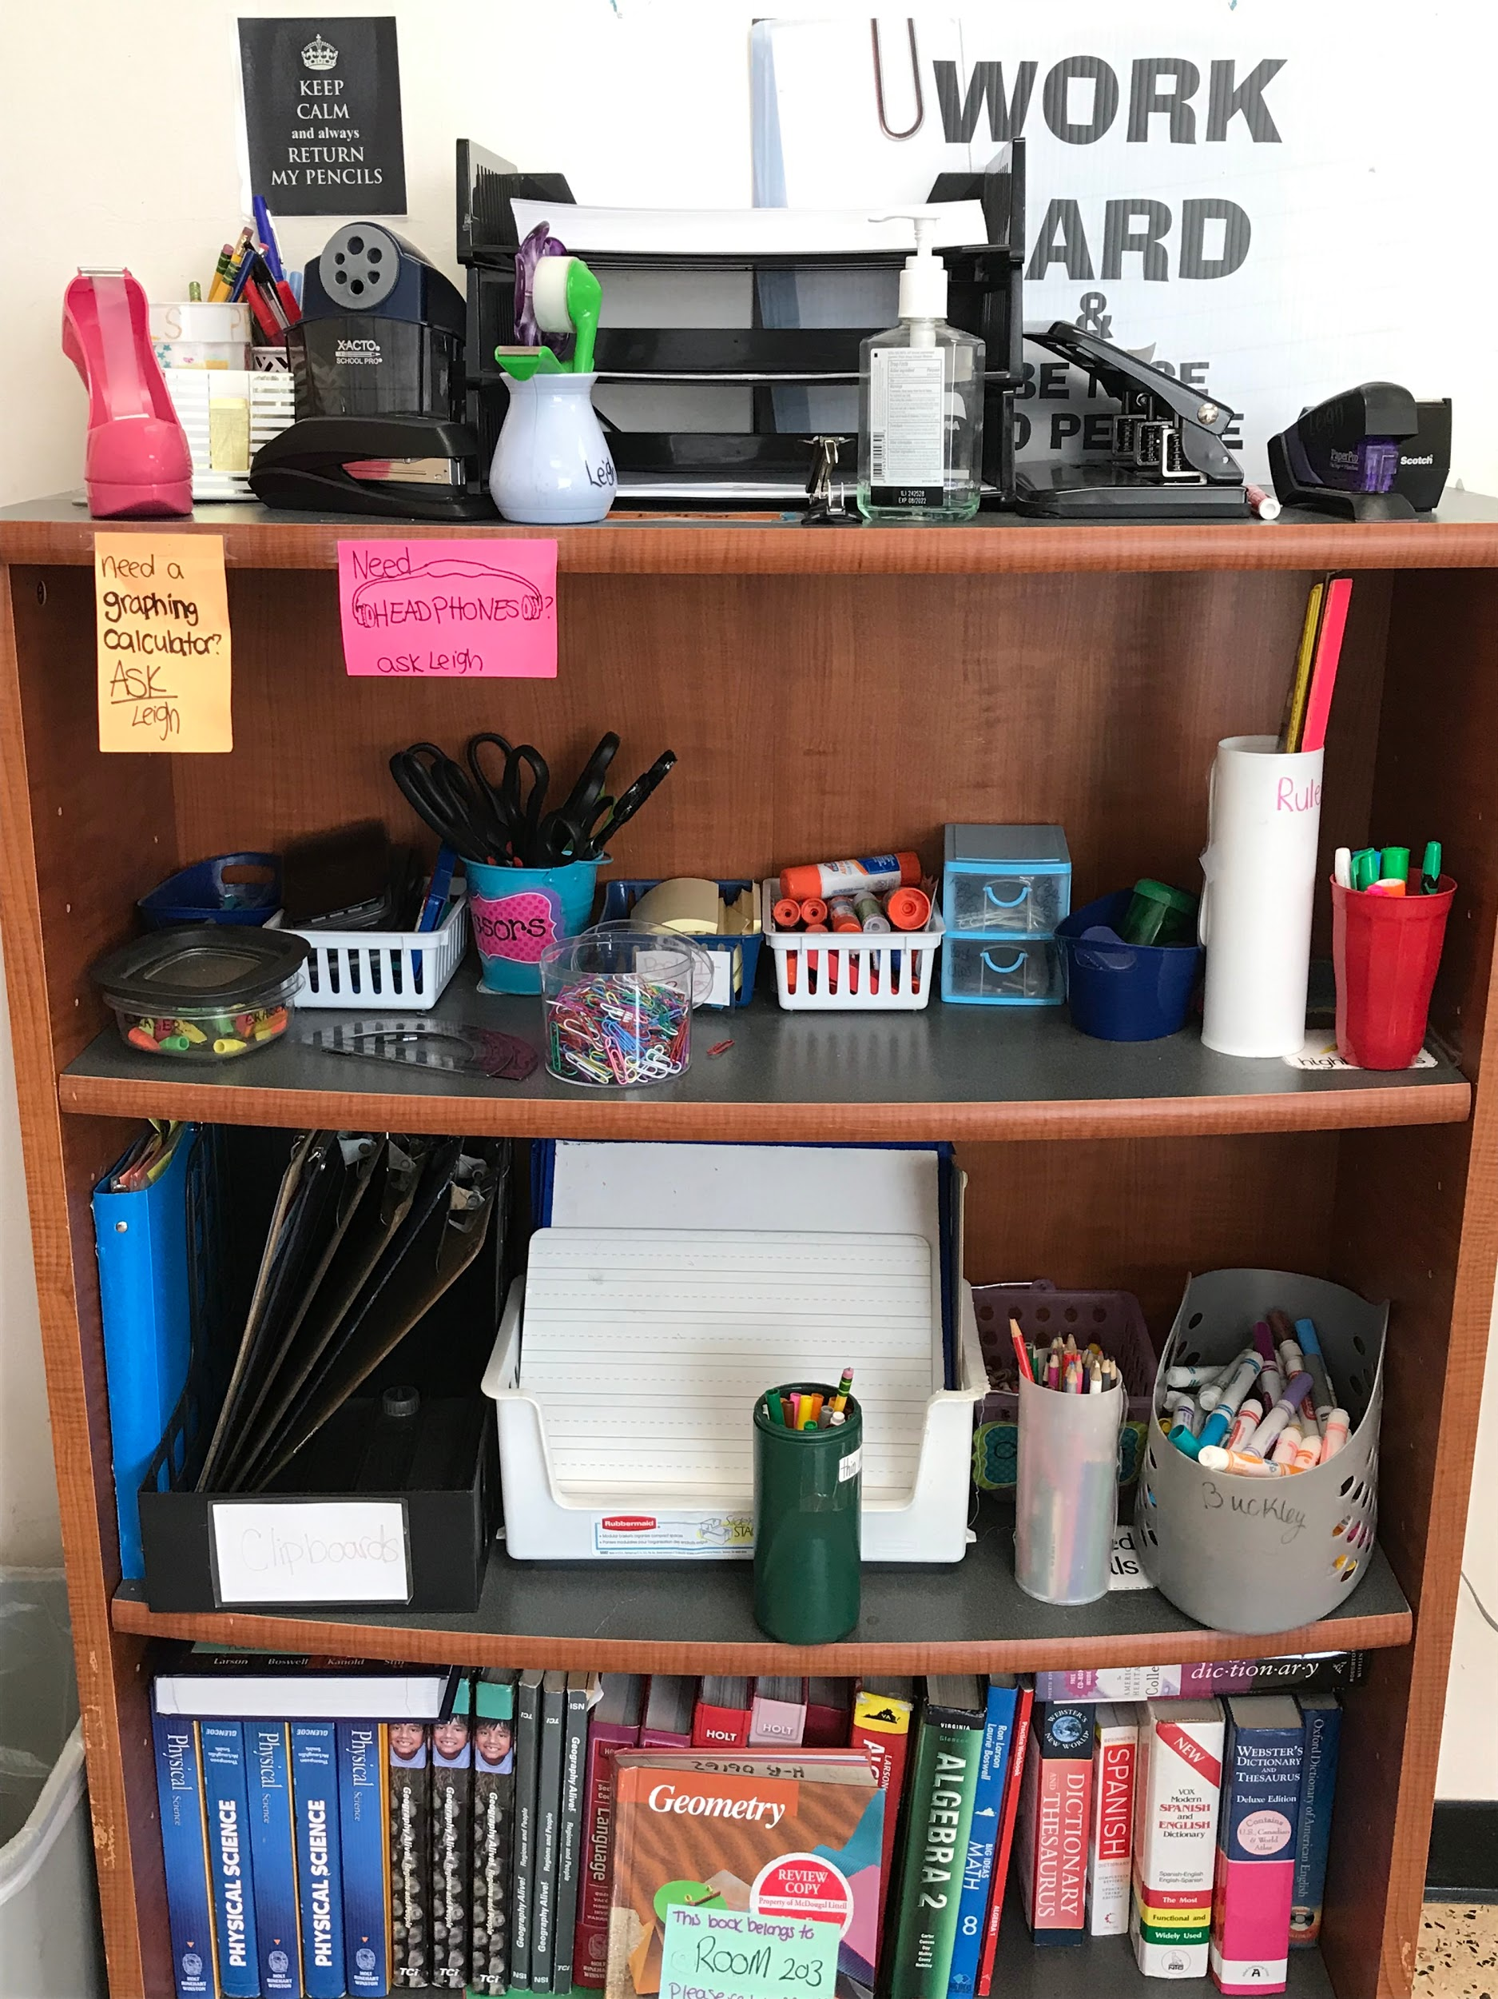
Classroom Examples
Have a place where tools are
available for students

Slide 39
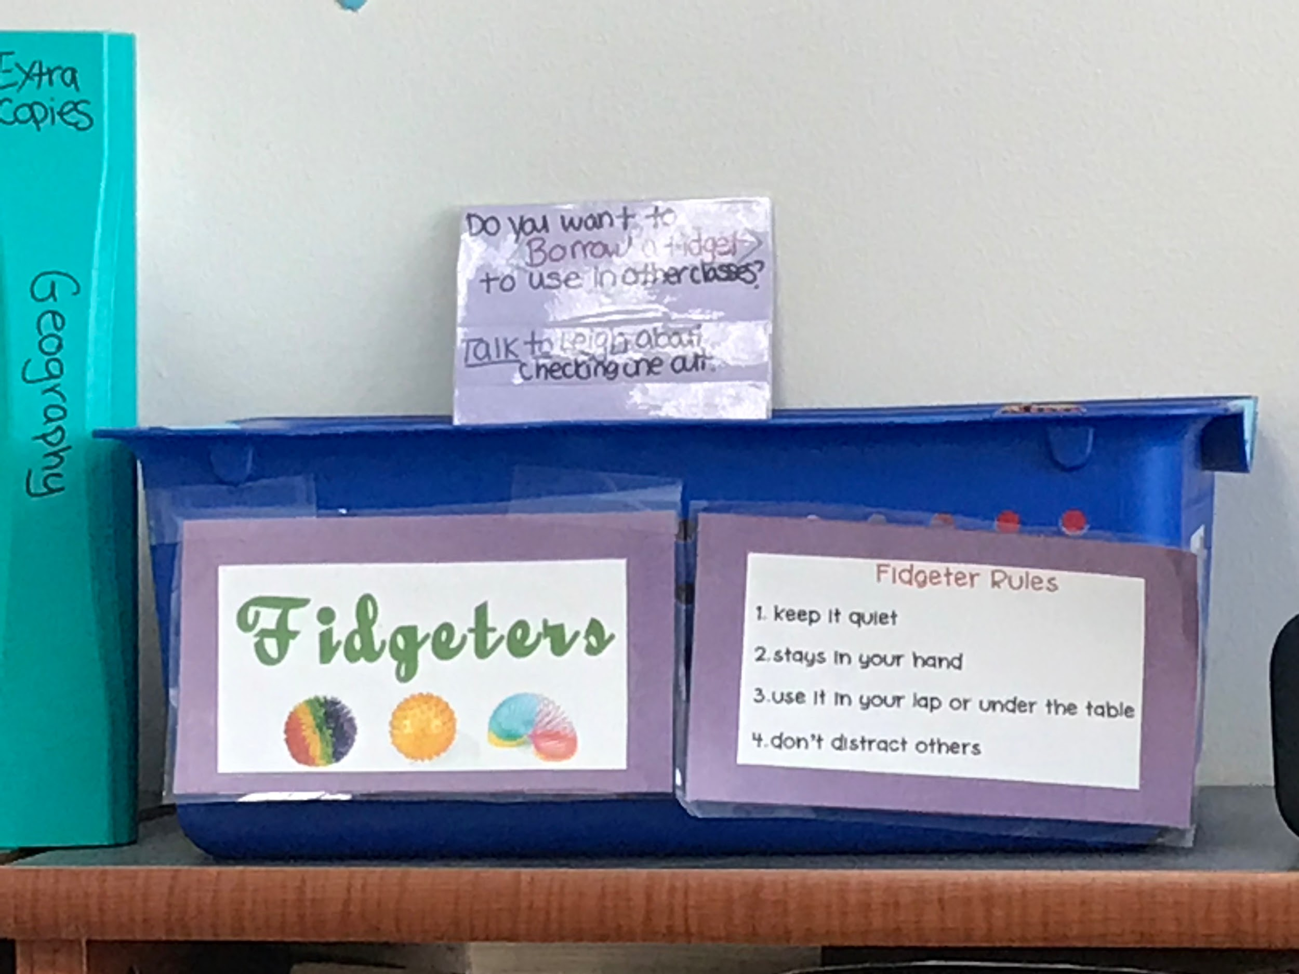
Classroom Examples
The tools and guidelines
for use
Notes:
Tool verses Toy!

Slide 40
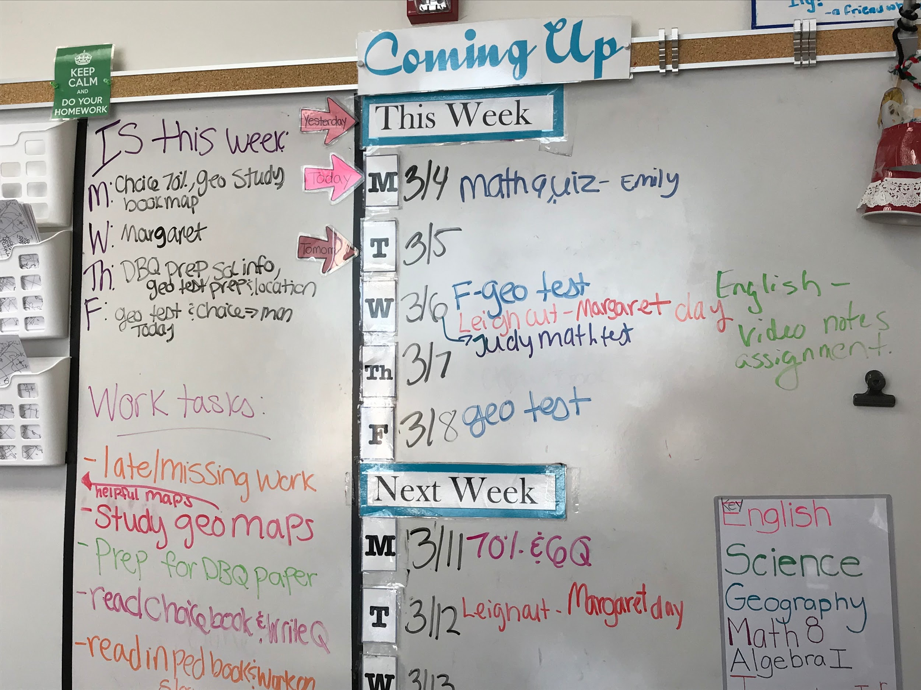
Classroom Examples
Resource teacher has board where she keeps track of major assignments, quizzes and tests so students have a reference available

Slide 41
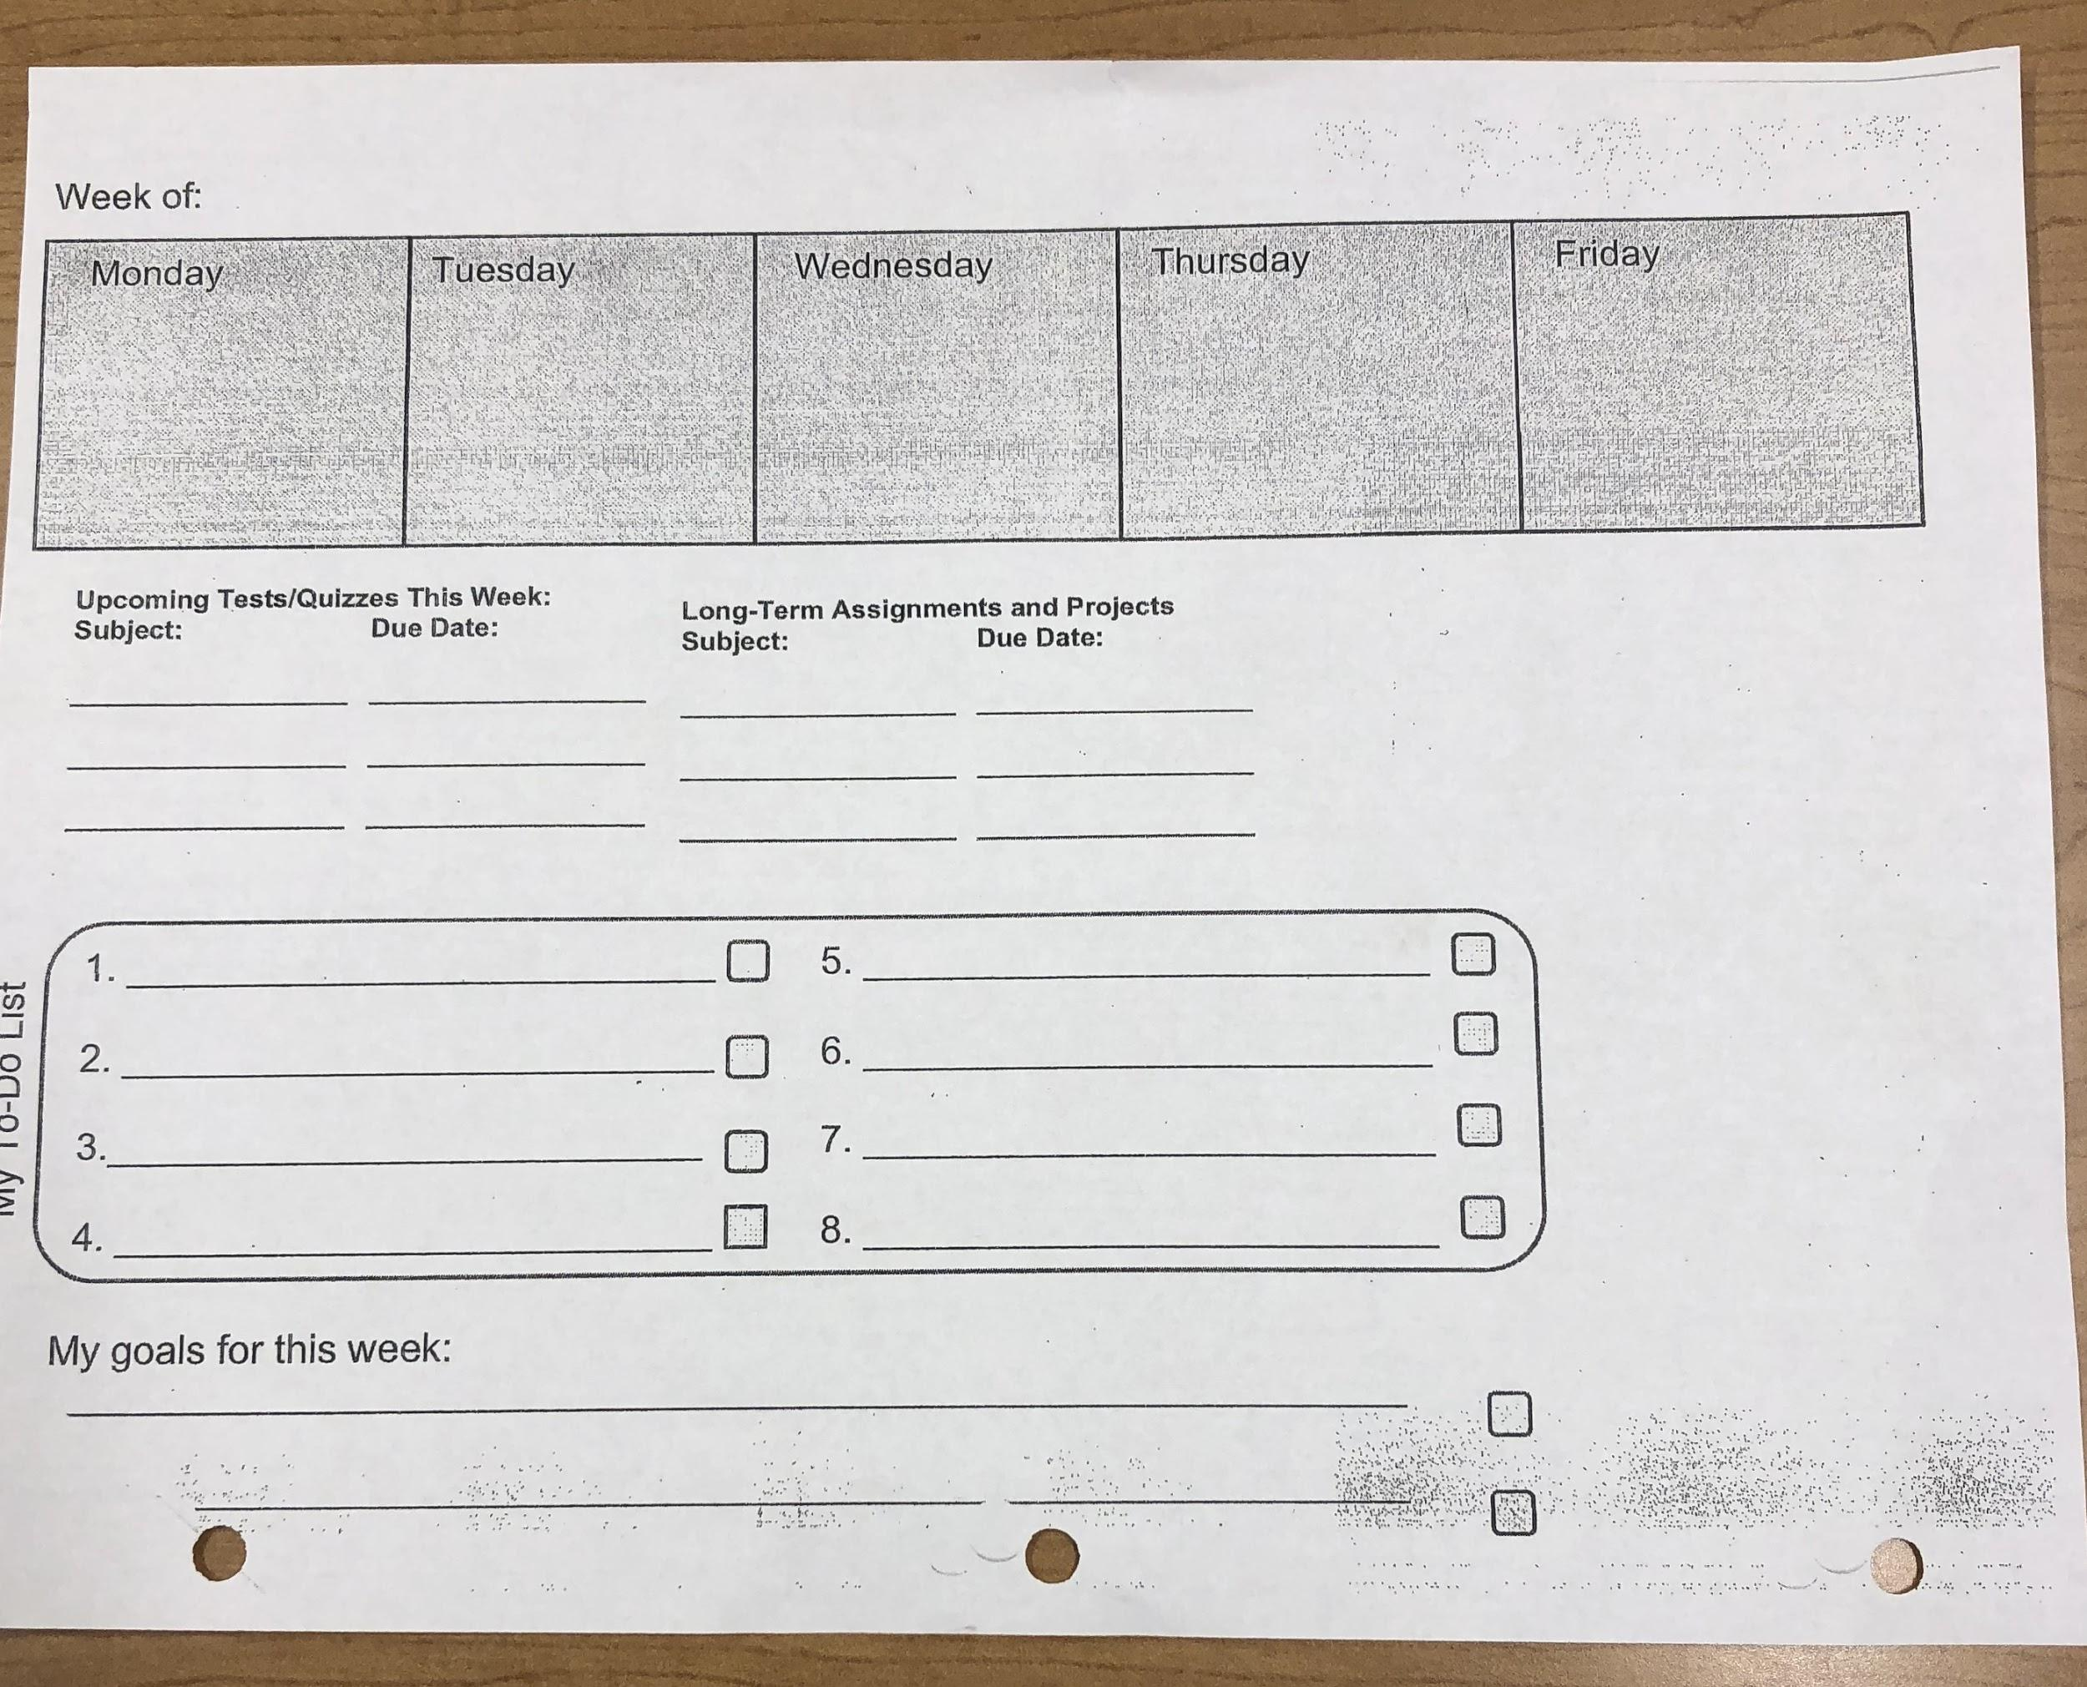
Classroom examples
BOY planner-
Gradually decrease how much info students need to include and then they can transition to more typical system- paper or electronic based.

Slide 42
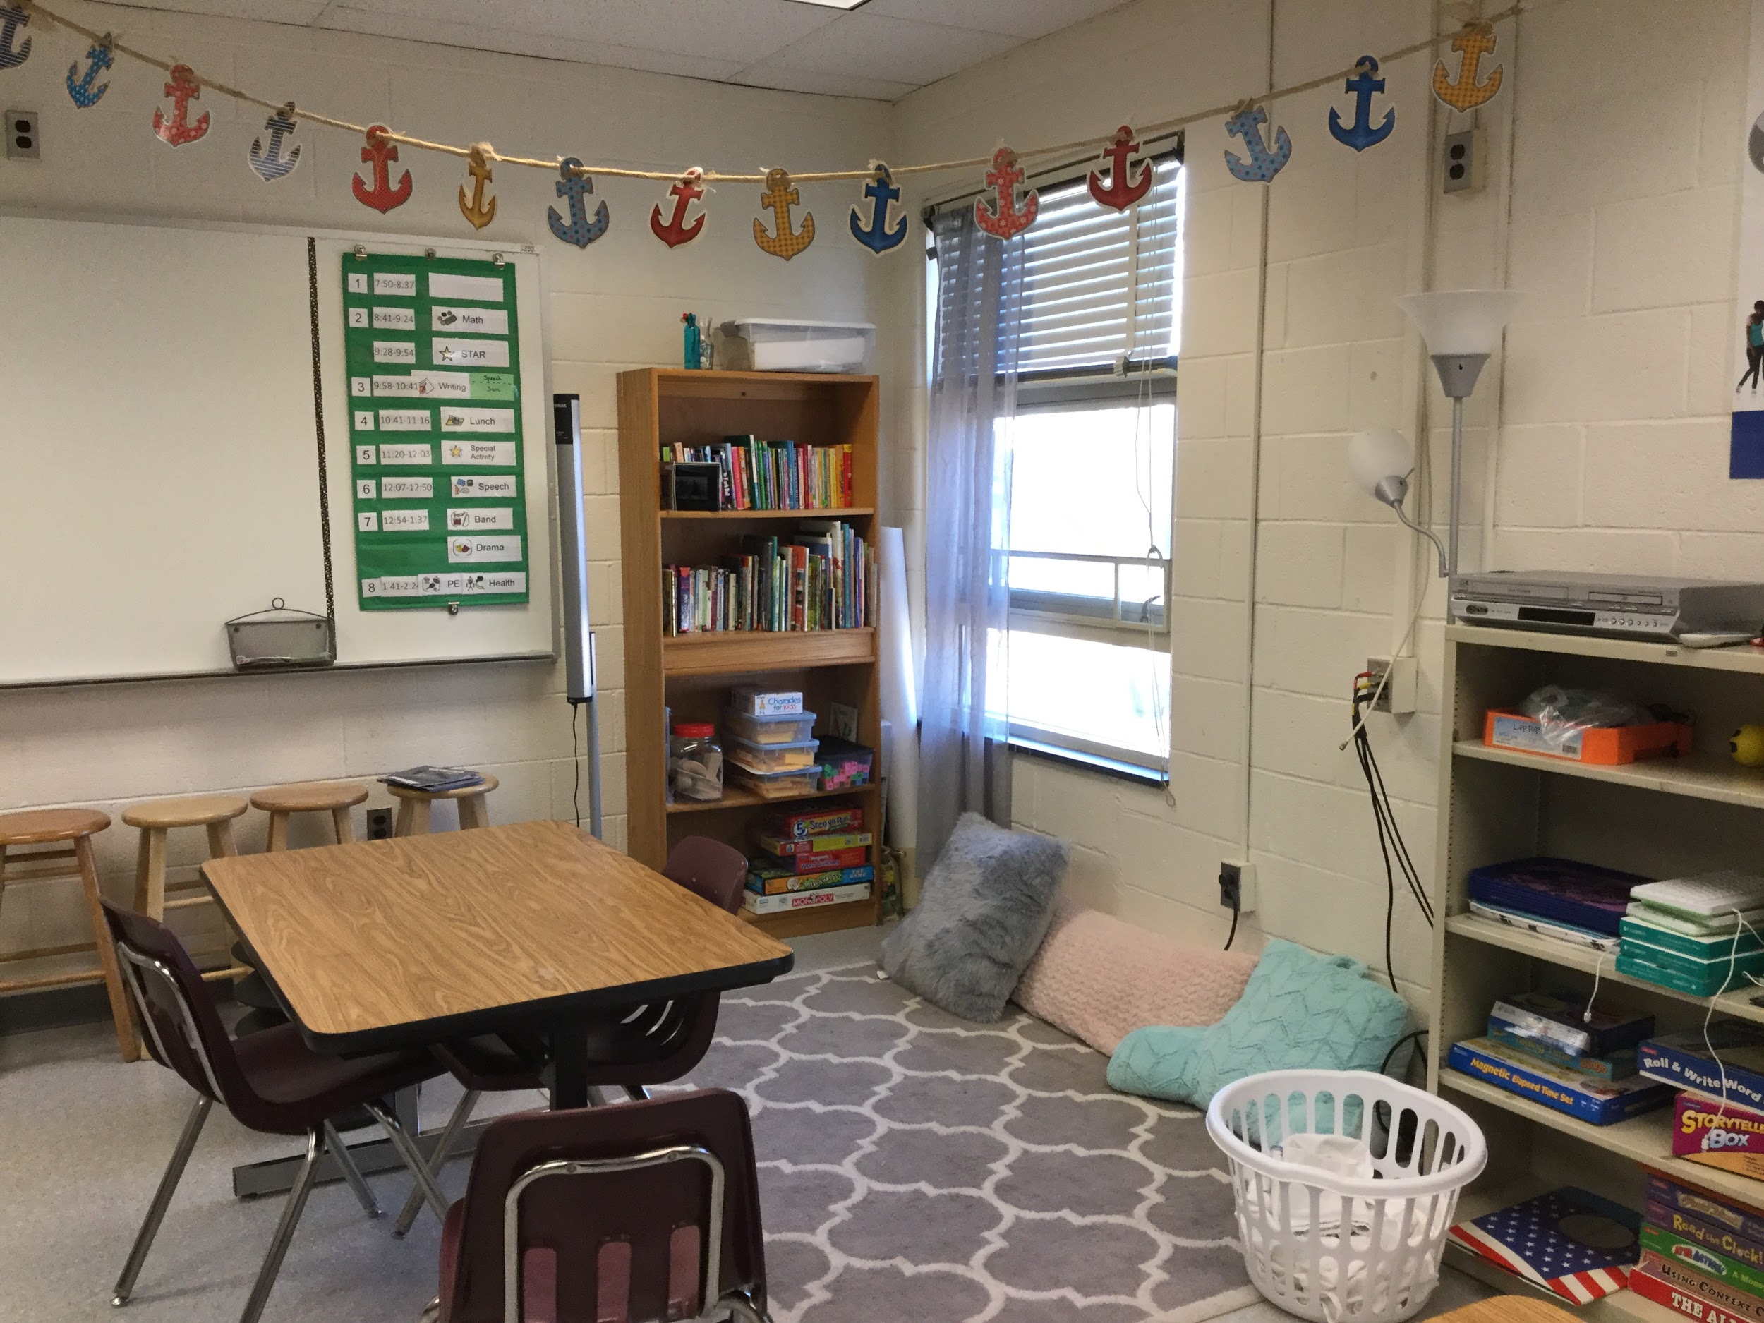
Classroom examples
Teacher has created a book area that is welcoming, has different seating options, and is not cluttered.
Classroom visual schedule posted using pocket chart.

Slide 43
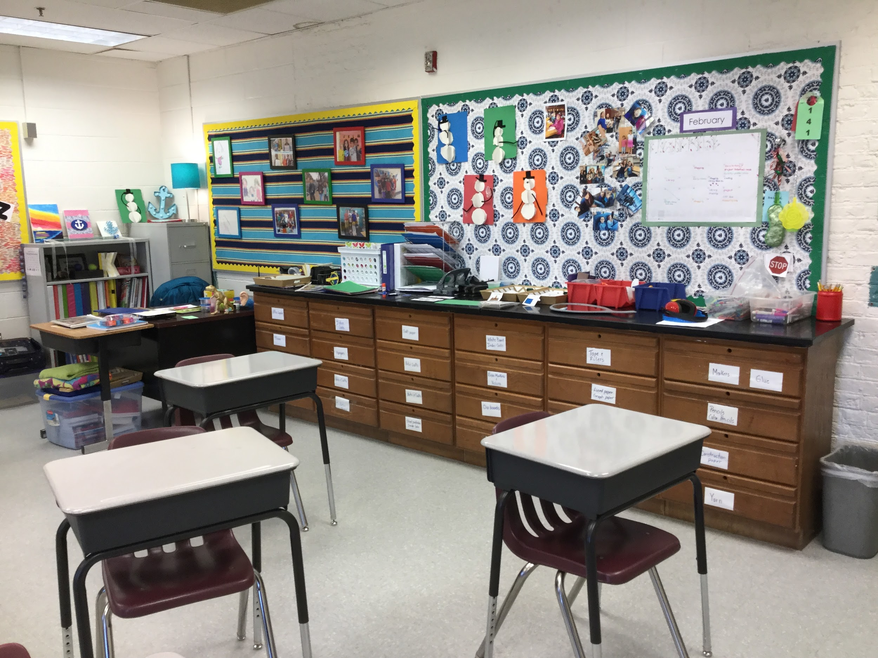
Classroom examples
Drawers are clearly labeled with contents.
Student work is posted but not cluttered
Calendar of long term assignments and special events posted here.

Slide 44
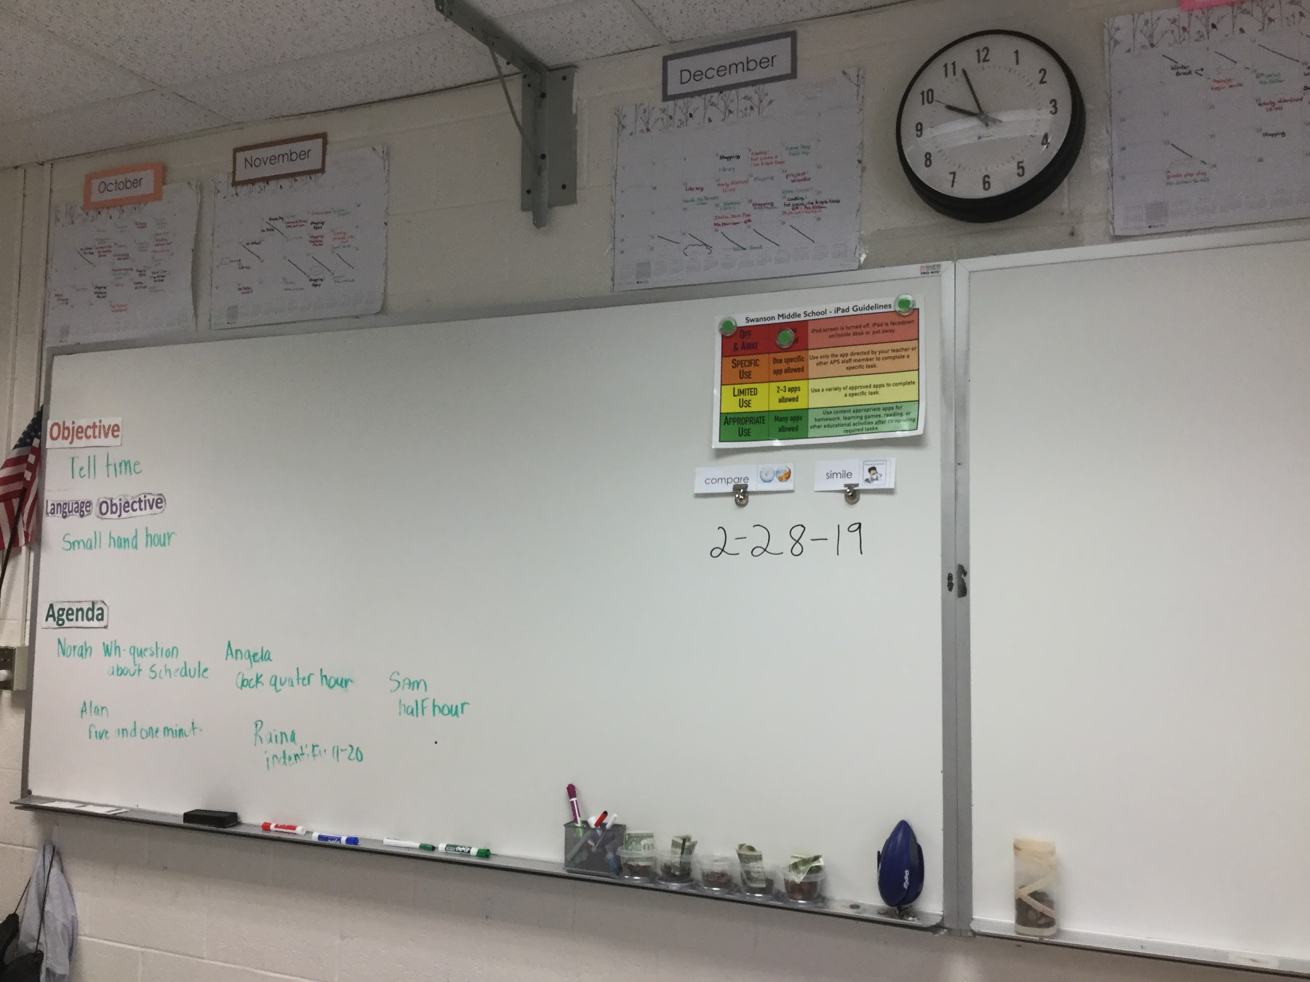
Classroom examples
Overall class objective, target language/vocabulary, and individual agenda for each student posted in a simple, direct manner.
Guidelines for iPad usage posted
Materials organized into buckets for student and teacher use

Slide 45
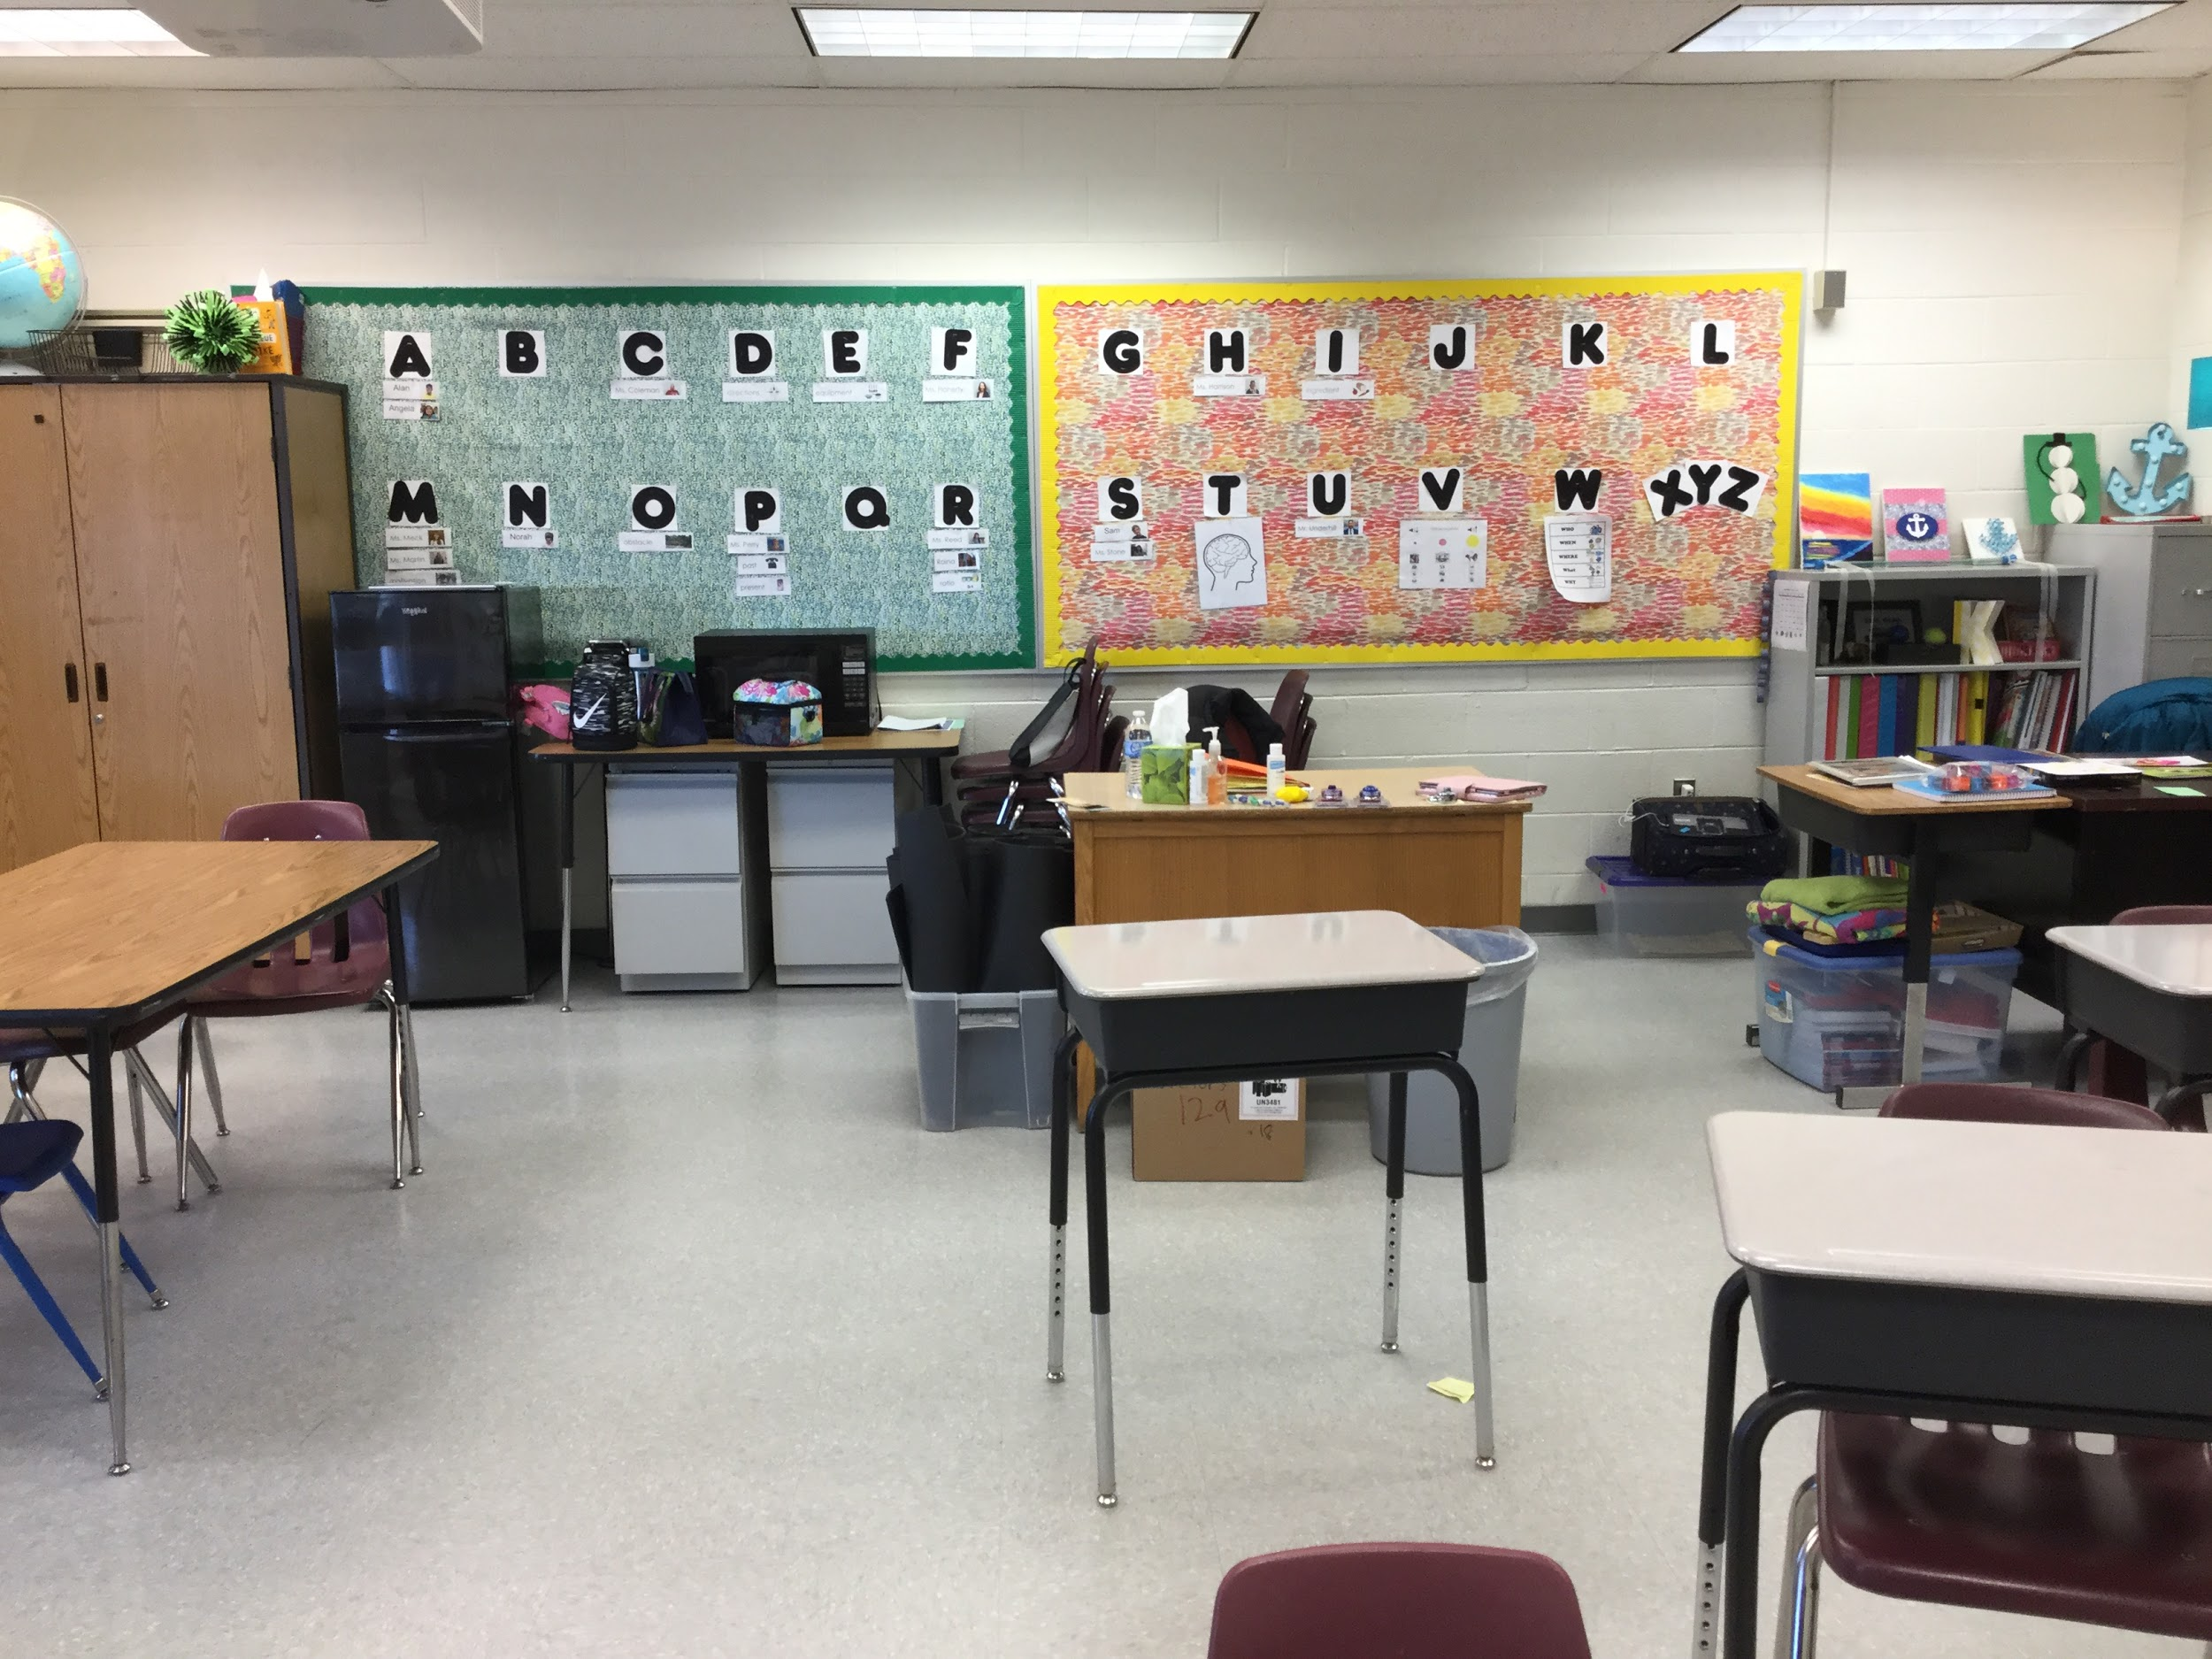
Classroom examples
Word wall (text and picture) to address student’s language and literacy needs
Clean and open spaces for moving through classroom.

Slide 46
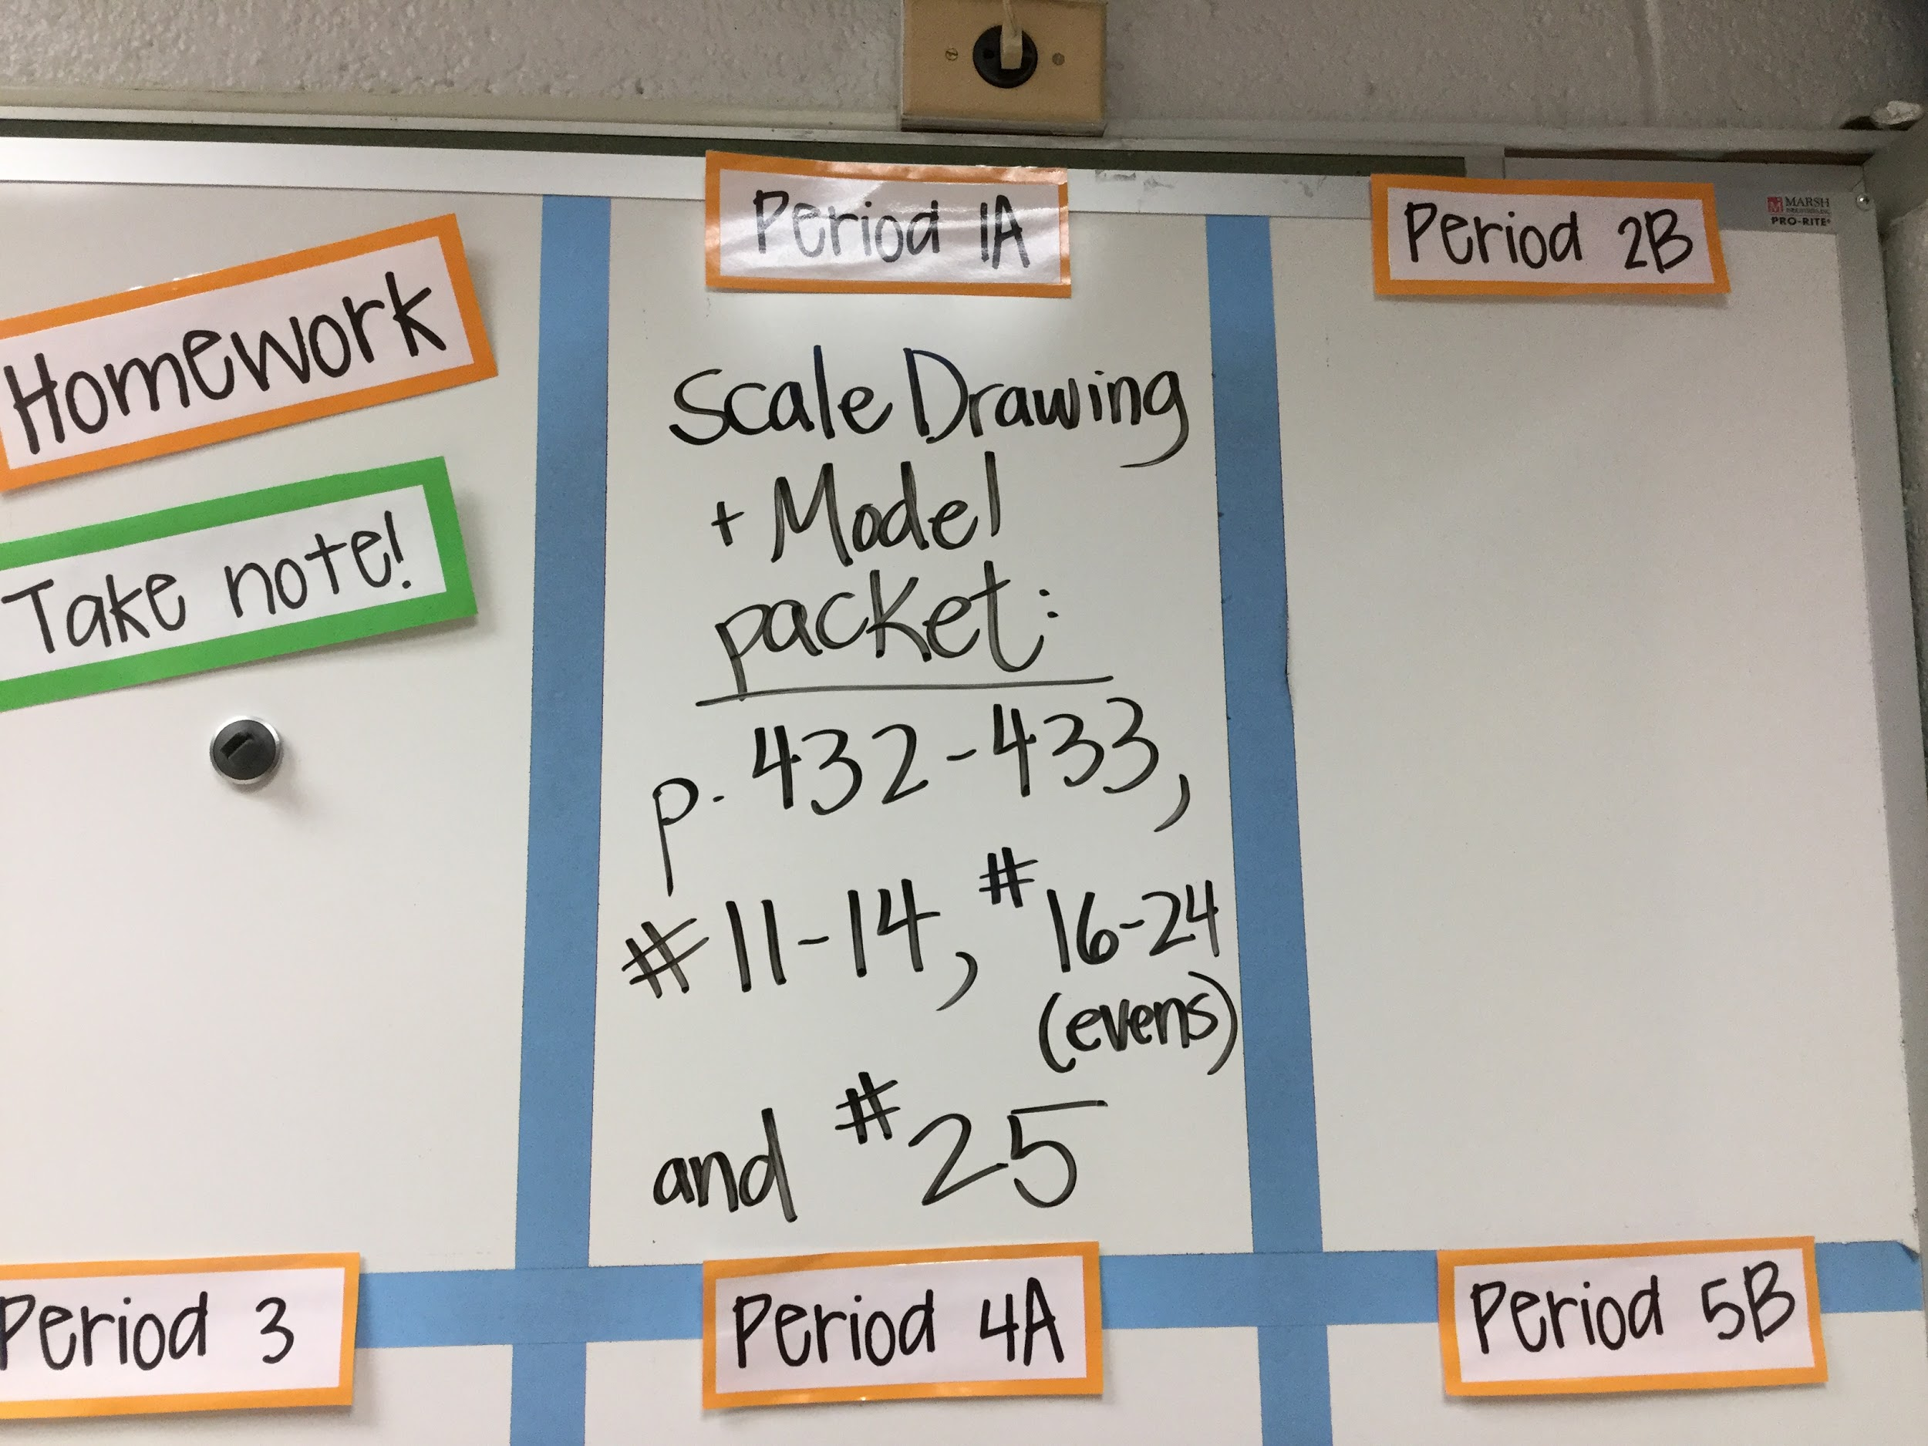
Spotted: What would you do?

Slide 47
Notes:
Marie Kondo; Tidying Up (Netflix)

Slide 48
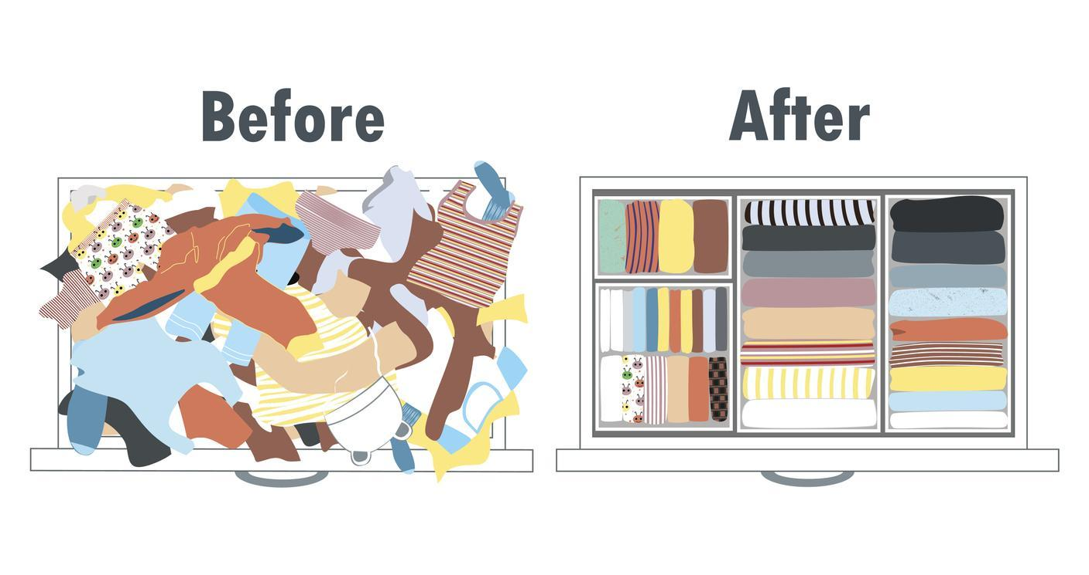

Slide 50
Case Study - Student
12 year old female student (7th grade)
educational classification OHI & medical dx of ADHD (does not take medication).
Strengths: math calculation and math reasoning, reading = significantly above grade level-Lexile 1332 (925L to 1235L=7th grade), passed all SOL’s (some passed advanced); strong written expression & spelling.
Areas of challenge: processing speed fell below average (WISC JV) which reflect a relative weakness. She scored significantly below average on her attention index (CAS 2014).
Motivated by technology and reading (reward for completing work).
Does not receive any related services.
Late to school ~ 3 -4 times a week.

Slide 51
Case Study - Environment
School: General Education setting
Math 8 for 7th grader, 3 immersion classes (Spanish, Social Studies, Science)
Favorite class: orchestra, English. Favorite part of the day: “dismissal”
Case Carrier scheduled to meet with student during homeroom
Student does not have an Instructional Studies class
Struggles to filter distractions during instruction.
Home: lives between 2 households with alternating schedules
Extracurricular activities (soccer, horseback riding)

Slide 52
Case Study - Tasks
Student required several teacher cues to initiate, stay on task and complete assignments.
She requires frequent check ins to redirect as she become easily distracted.
The referral team wanted Student to do the following tasks that she was not able to do at time of referral:
1. “Learn to be organized and prioritize tasks and assignments”
2. “Become independent with tracking and completing assignments”

Slide 53
Case Study - Tools already in place
Tools- team/student had been using:
Computer with software for word processing (Google Docs) and leisure
Mini mouse
Touch screen on tablet
Software: Pinnic, Explain Everything, Numbers
Positive Behavior Supports/Organizational Strategies:
Classroom visual schedule (posted agenda)
Transition routines and cues
Communication Strategies
Timer
Individual visual schedule
Fidget items/sensory tools

Slide 54
Case Study - Tools recommended
Tools- recommended team consider:
Increase self advocacy: www.imdetermined.com
Surrender book
Set goal # of problems (gradually increase)
Set timer on her iPad (gradually increase)
Review accommodations-know what she needs & how to ask for it
Organization
Consider Instructional Studies- consistent support and attendance, clean sweep binder weekly
Built-in features: reminders, voice typing, Google Doc- folders for classes
Title and date every document, then file it
Student participate in developing a productivity tool
Colored rubber band prompt homework
Launch Pad at home, homework center
Notes:
Increase awareness & insight: self-assess,self-manage & self advocate.

Slide 55
Small groups
Share about a current case
What do you know
What additional assessments may be helpful
What tools/strategies may support student performance

Slide 56
“Sometimes you will have to model the metacognition needed in self-assessment. Sometimes you need to model the decision-making process…Students need to see what it looks like in action.”
Empower by: John Spencer and A.J. Juliani

Slide 57
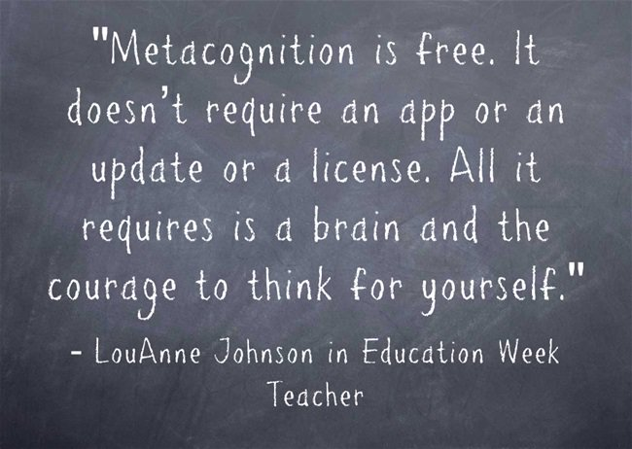

Slide 58
What STUCK with you from today’s discussion?

Slide 59
Questions/Comments? Contact Us
Marbea Tammaro, MEd, OTR/L
Marbea.tammaro@apsva.us
Sandi Stoppel, OTR/L
Sandra.stoppel@apsva.us
Lauren Bonnet, PhD, CCC-SLP
Lauren.bonnet@apsva.us
@APS_AsTech

